Slide 1

PLANT VS ZOMBIES
AP PROJECT :- 3

Slide 2
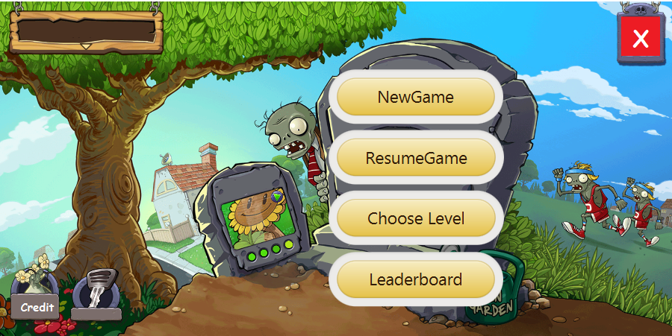
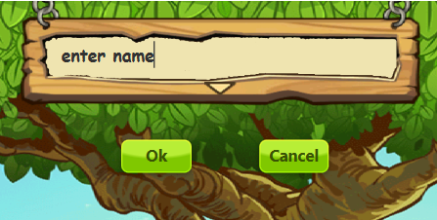
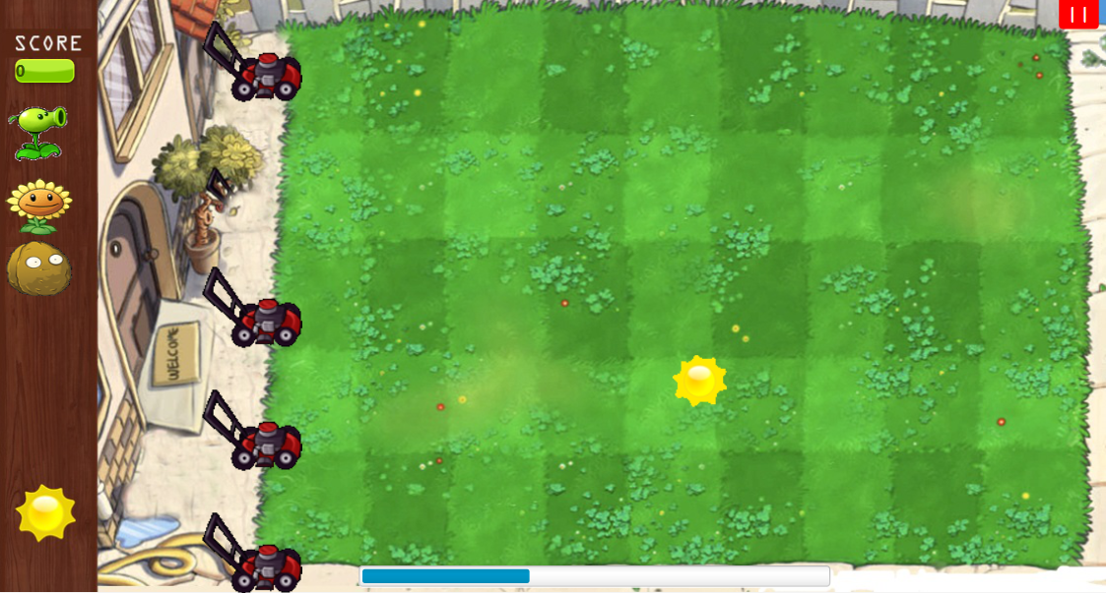
Designing the Game
Our major effort in designing a user friendly interface with minimalistic complexity as possible.
Home page -- Base page giving you option for new game, levels, credit and quit.
Level page to choose level and login page designed specially for loading and saving of current game and resume page continues saved game , where as credit page shows the shows the credit , and leaderboard shows the name of the persons having high score.
Main backyard- This page is main game which also have pause button and a posses track of tokens and plants and contains time bar .

Slide 3
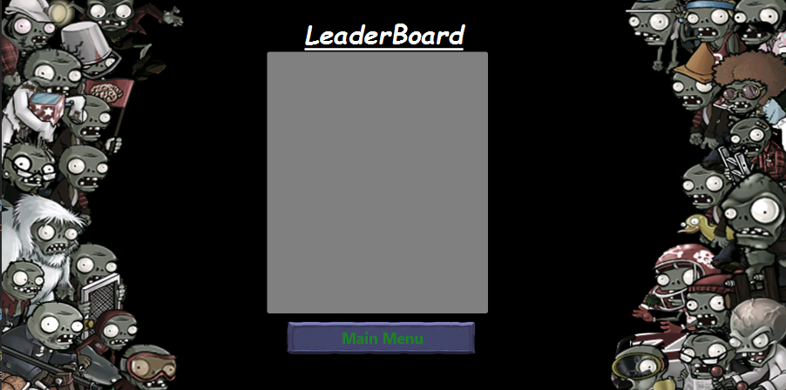
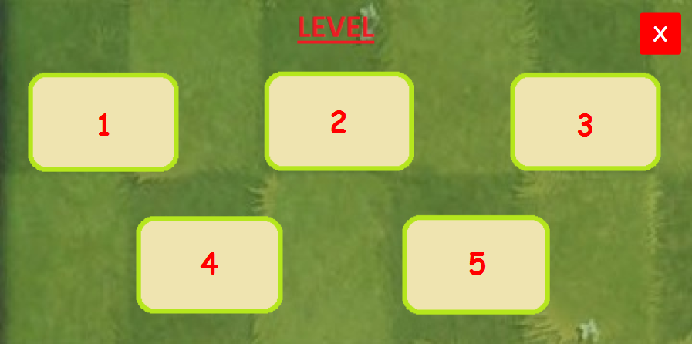
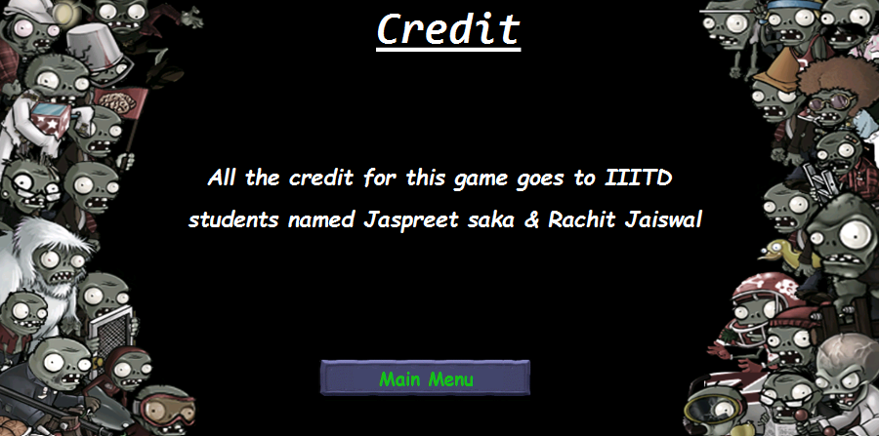
Implementation of Game
All the pages are implemented using java scenebuilder (Gluon).
Main game play is executed using Drag and Drop .
Main OOP concepts such as inheritance and polymorphism are used in main game.
Serialization and deserialization is used for save purpose of the game.
To check bugs this game is tested by some anonymous users and solved

Slide 4
Individual Efforts
Rachit Jaiswal : 1. Implementation of core code and major backend working of game. 2. Assisted in basic design, worked upon exciting ideas to making game more attractive. 3. Handled testing and debugging of core code.
Jaspreet Saka : 1. Working on design and outlay of game. 2. Implementing designs, Static GUI programming, assisted in core programming of game. 3. Worked on testing of design and debugging some errors and mishappenings

Slide 5
THANK YOU !
Jaspreet Saka (2018237)
Rachit Jaiswal (2018404)

